Slide 1
Contractor
Line Item Container and
Estimate Software
Team: sddec21-05
https://sddec21-05.sd.ece.iastate.edu/
Faculty Advisor: Alexander Stoytchev
Client: Buildertrend
Notes:
Thought I would start this presentation, we should model it after the design document

Slide 2
Our Client
Team 5 - Contractor LIC and Estimate Software
Notes:
Buildertrend is focused on home builders, remodelers, specialty contractors, and general contractors. They combine project scheduling, project management, financial management, customer management, and service management all contained within their ecosystem

Slide 3
Problem Statement
Our client needs a system that can automate the process of building and quote preparation for home renovation and construction projects. The system should support multiple line items that can be customized based on the type and quantity of each material for each sub-project. The system should also handle on the fly customization such as discounts and markups. Similar tasks for each client’s results should be stored in the database so they can be used later. The software would automate the process of preparing quotes for potential customers and replace the current system that is based on manual entry.
Team 5 - Contractor LIC and Estimate Software
Notes:
Buildertrend’s feature to allow customers(whom they refer to as builders) to create an itemized estimate of a projects overall cost. To do this, a builder would store each material as a separate line item. If an update was made to the design of the house, everything related to the change would be updated

Slide 4
Problem Statement cont.
Our client has emphasized that ease of use of the application should be a priority. The application should be designed with an easy learning curve in mind. The software should be developed to be contained within the Buildertrend ecosystem and fit in stylistically with other Buildertrend tools.
Team 5 - Contractor LIC and Estimate Software
Notes:
Explain how that there may be solutions out there, but they would be external to Buildertrend’s line of products and require customer to deal with acquiring licensing to other company’s (top one to think of would be excel)

Slide 5
Project Plan
Our plan was to create a line item container with:
Functionality for an easy transition
Ability to create/edit/delete items
Parameters in calculations
Some main functions we implemented are:
Parameters
Trickle down parameter deletion
Team 5 - Contractor LIC and Estimate Software
Notes:
Our solution to the clients problem is to create a web application similar to our clients current line item container.

Slide 6
Frontend Architecture
React:
A JavaScript library for building user interfaces
Material-UI:
Third-Party React UI Library
Team 5 - Contractor LIC and Estimate Software
Notes:
For the front end, we will be using React and Material UI to create the website and UI features. These tools were recommend by the client as they are primary tools they use and if the client decided to move forward with our design implementing our design should be stress free.

Slide 7
Backend Architecture
Linux Ubuntu Server
ASP .NET Web API - A connector for HTTPS requests from the React app
ASP .NET Business layer logic - A layer that takes the requests from the Web API and performs actions
SQL Database - A layer for storing and retrieving data from
Team 5 - Contractor LIC and Estimate Software
Notes:
In the back end we will be using a linux server provided by ISU to host our project and connect our website to our database. We will be using .NET for any HTTPS request

Slide 8
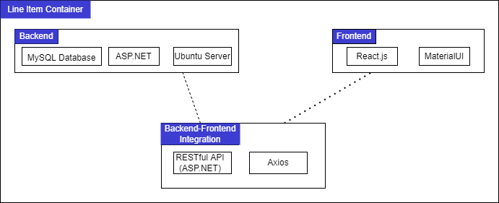
Overall Architecture
Team 5 - Contractor LIC and Estimate Software
Notes:
“This is a picture of how we see the system encapsulated. The contractor should only have to deal with the interface shown in the screen sketches in previous slides.”

Slide 9
Functional Requirements
Recreate a basic version of Buildertrend Line Item Container as a React component
Create functionality to create/read/delete parameters and use them in the line item container
Create logic to add and compute the major formula types inside line item fields
Team 5 - Contractor LIC and Estimate Software

Slide 10
Non-Functional Requirements
Environmental
React, .Net, MySQL, Ubuntu server
Performance/Scalability
Works with large data and needs to be accessed promptly
Notes:
There was a lot new technologies that the team had to learn throughout the project

Slide 11
Front-End Design
Requirements:
Easily readable
Quick to learn
Not visually overwhelming
Modern and simplistic

Slide 12
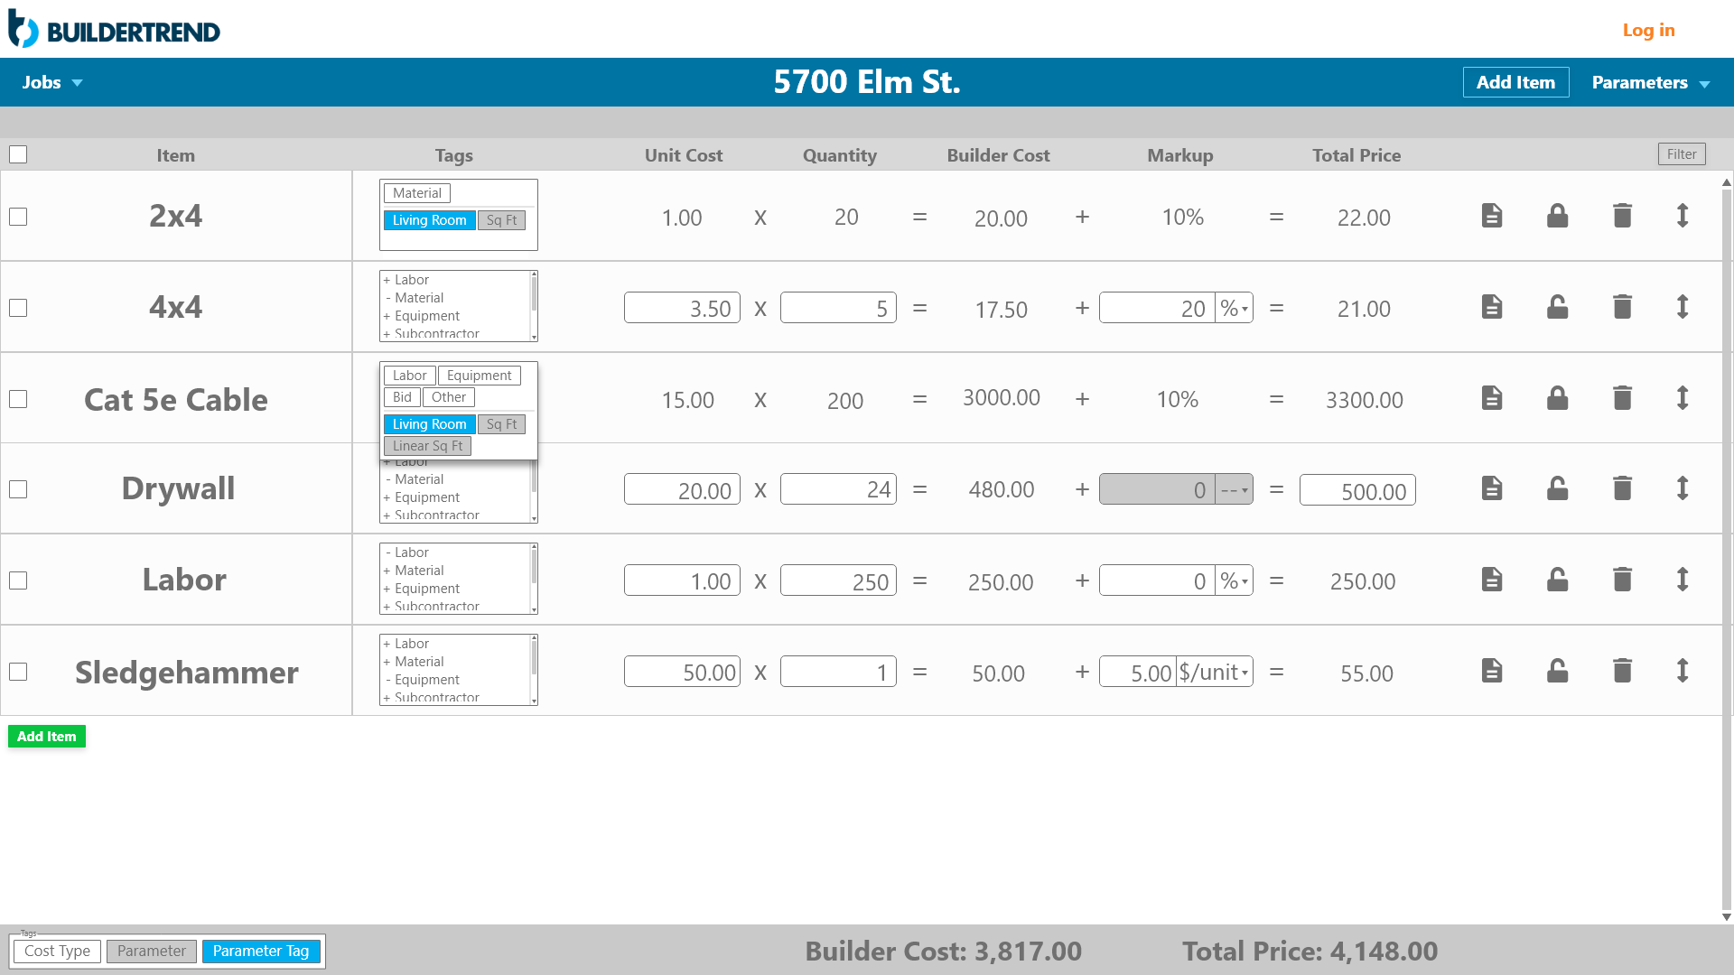
Front-End Design

Slide 13
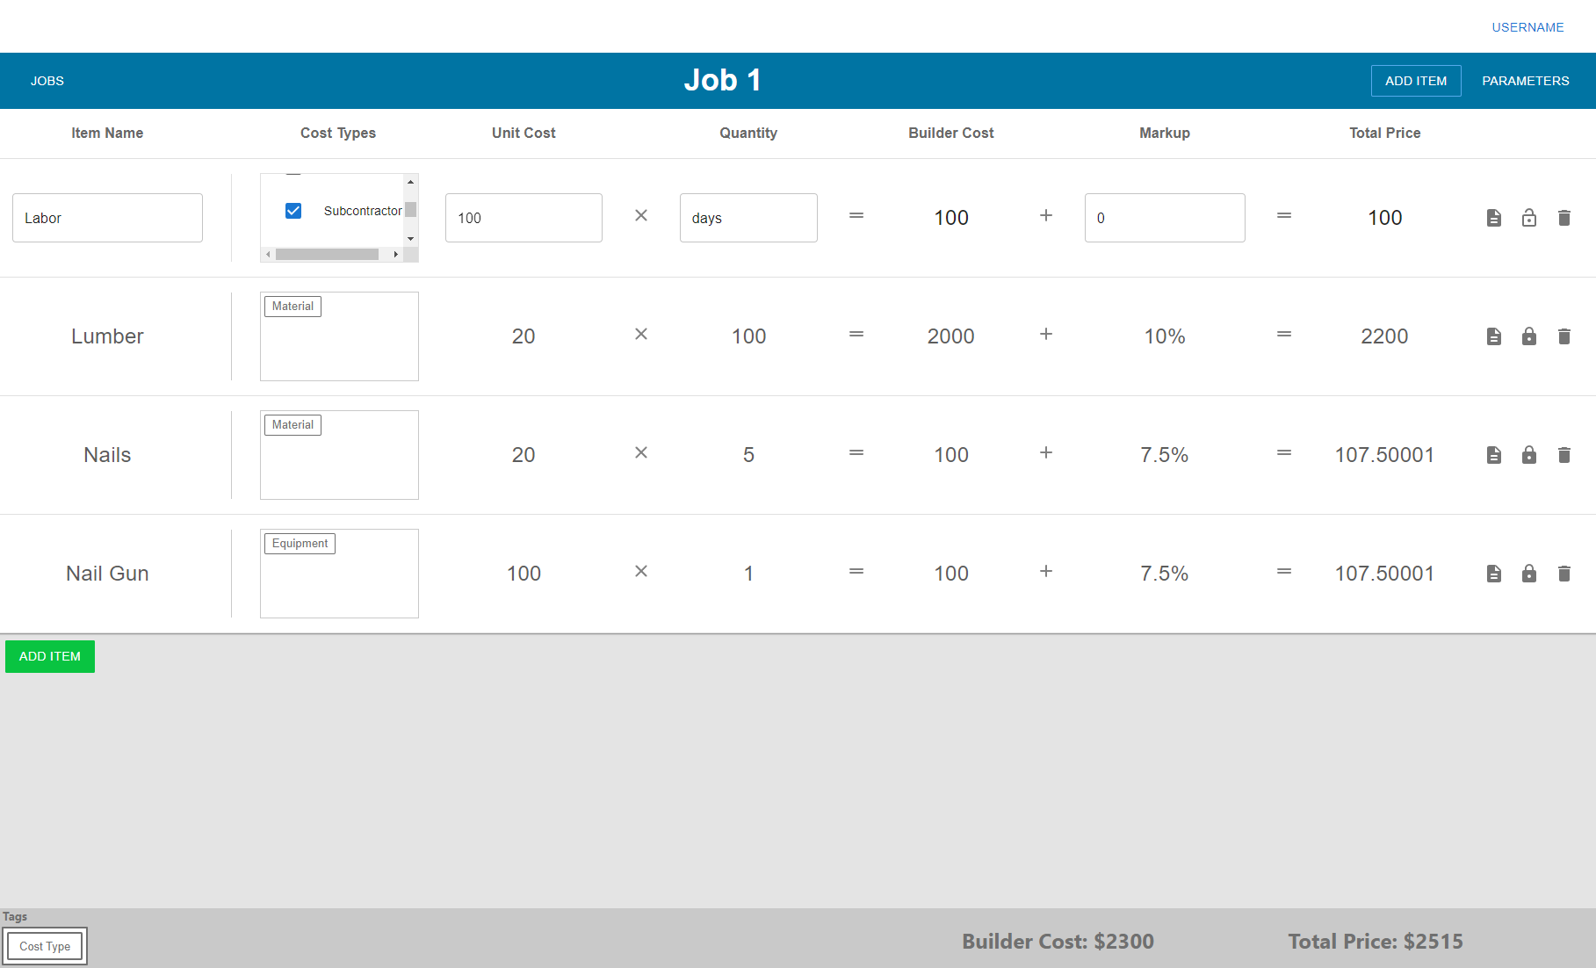
Front-End Design

Slide 14
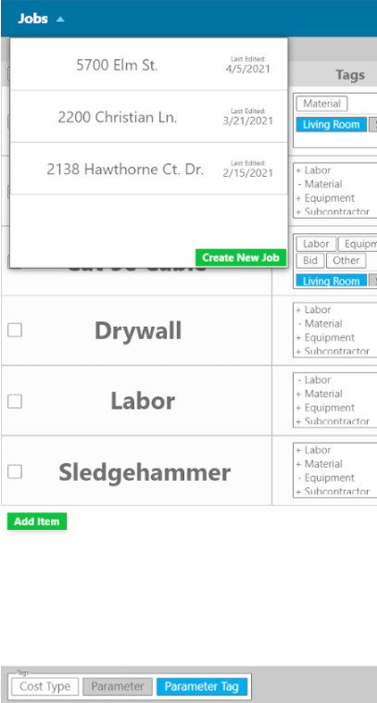
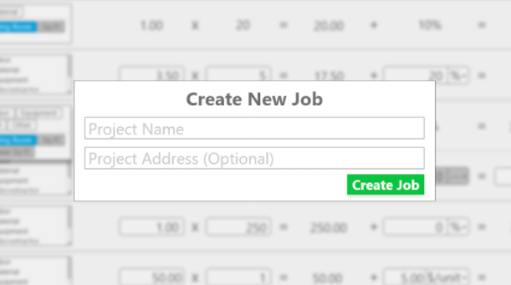
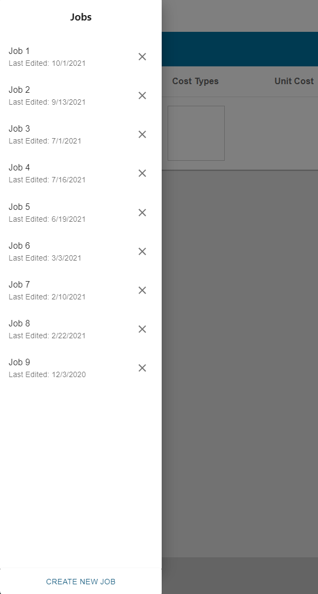
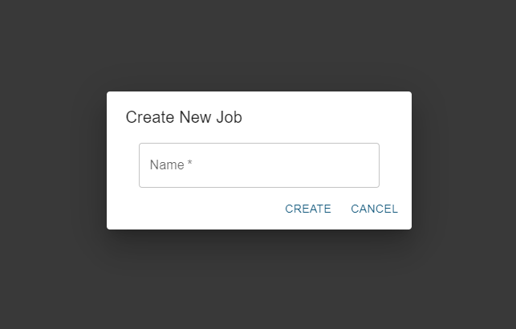
Front-End Design

Slide 15
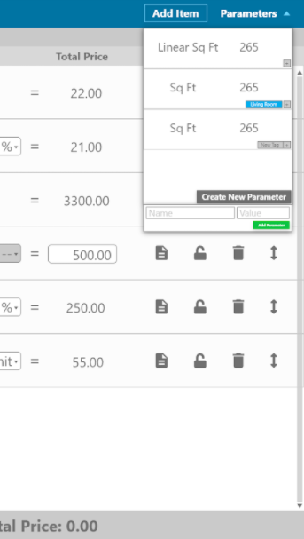
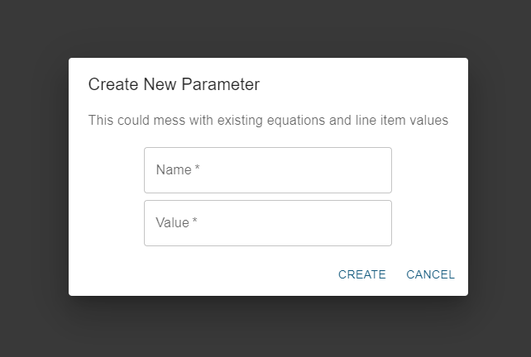
Front-End Design

Slide 16
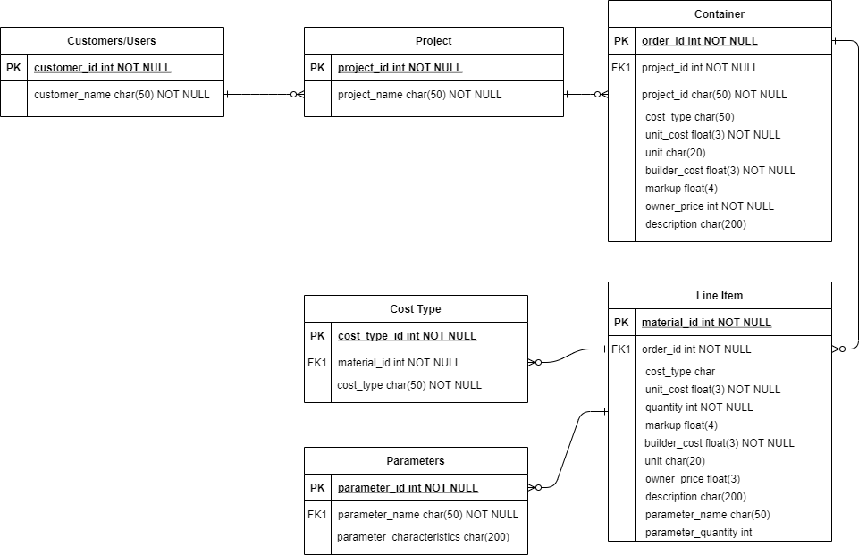
Database Design
Team 5 - Contractor LIC and Estimate Software
Notes:
In this picture you can see our SQL schema. We have projects which contain containers which contain line items. We also have tables to store parameters and cost types as well as the proper foreign key constraints to allow for appropriate deletion (child gets deleted when parent does)

Slide 17
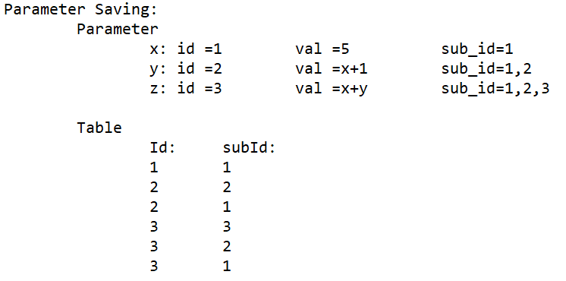
Parameters Functionality
Added SQL table to keep track of relations
Allows for proper updating and deleting
Recursively searches through table to allow nested parameters
NCalc to parse for calculations

Slide 18
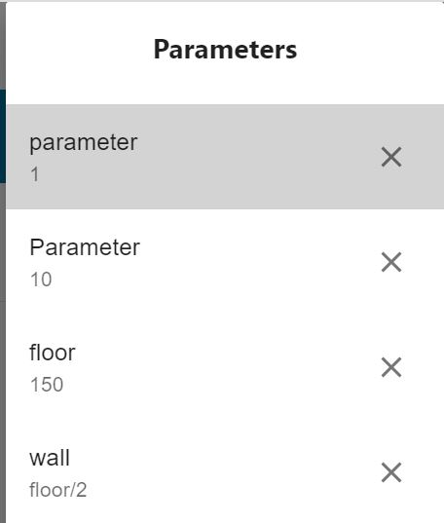
Parameters
Allows users to seamlessly reuse parameters throughout their project
Create new parameters and delete old ones
Insert into unit cost to perform any calculations
Allows for multiple parameters and formulas containing parameters

Slide 19
Testing Methods
Front End Testing
POSTMAN and SWAGGER
Back End Testing
SQL Workbench
NUnit for server side testing (.NET version of JUnit)
Isolated unit testing of basic features
Adding a new line item to the container
Locking a line item in React
Interface testing between application and database
Creating/Updating/Deleting parameters and line items
Saving line items with formulas
Manual Testing for acceptance testing
Team 5 - Contractor LIC and Estimate Software

Slide 20
Risks
Client merging with another company, inheriting solution from that competitor
Change in product requirement due to merging with company
Not accounting for certain edge cases
Might need to integrate with new product
University of Nebraska working on a similar project
Team 5 - Contractor LIC and Estimate Software

Slide 21
Risk Management
Keep documentation up to date
Try to keep code clean and up to standard
Do what we think is best design wise
Follow best practices and perform error checking
Team 5 - Contractor LIC and Estimate Software
Notes:
ABle to manage those risks from buildertrend. TO counter in changes in product requirements we will need to revise our project structure until it is acceptable to our clients. Ability to adapt with different integration of products like ofr example new version of environment software. A way to manage university of N by having an better design ideas so the clients can choose our design ideas over them.

Slide 22
Constraints and Considerations
Use the React and .NET frameworks
Design should be similar to their existing line item container
Must be able to operate on a web application
Ability to withstand thousands of line items
Throw errors when users input invalid values in line item container
Team 5 - Contractor LIC and Estimate Software

Slide 23
Lessons Learned
Use company resources
Allocate more time for initial project configuration
Try different ways to find better development designs as a whole team
Not everything will go as planned when making the final design in web applications
Gained knowledge on using REACT language to create web applications
Coding with 2 or more people increased productivity

Slide 25
Acknowledgements
We’d like to thank Buildertrend for providing us with this opportunity.
We’d like to thank Professor Daniels for organizing the class this semester.
We’d like to thank our faculty advisor, Professor Stoytchev for his feedback and advice.
Team 5 - Contractor LIC and Estimate Software

Slide 26
Questions?
Team 5 - Contractor LIC and Estimate Software

Slide 27
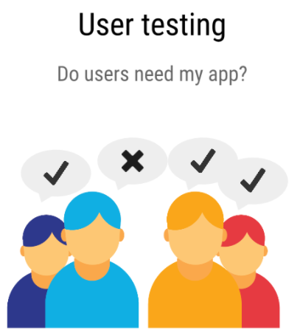
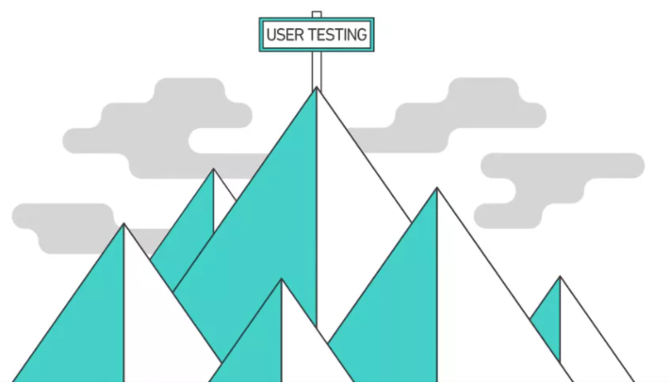
User Testing/Uses
Arrange a number of people to test our project.
Create a set of scenarios for testers to follow.
Use Google Forms to get user input.
Compile all the User Testing results and fix/improve the bugs or visual aspects.
The main intended user is a project manager or construction worker that is using Buildertrend’s tools. Currently, Buildertrend does not have a tool for computing material cost

Slide 28
Testing Plan
Interface
Testing
No
Implement best solution
Unit test basic features
Pass?
Pass?
Yes
System Acceptance
Testing
Yes
Regression Testing
No
Determine best solution
No
Pass?
Yes
Done
Team 5 - Contractor LIC and Estimate Software

